Slide 1
Revisiting the burden of TB in pregnant and post-partum women
Nyashazaishe Mafirakureva

Slide 2
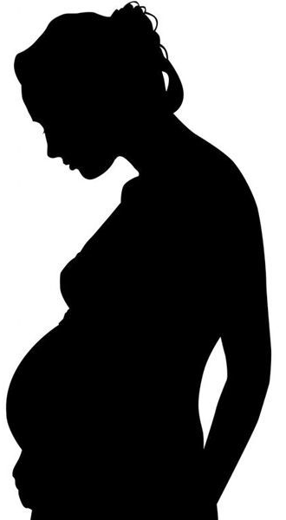
Revisiting the burden of TB in pregnant and post-partum women
Nyashazaishe Mafirakureva

Slide 3
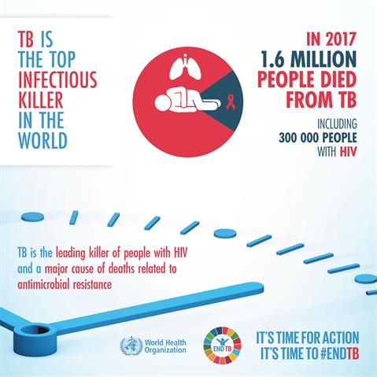
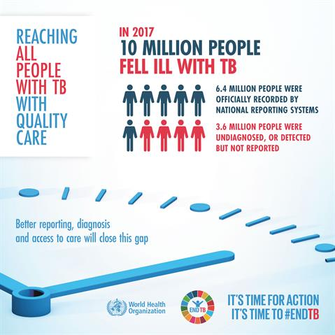
Global burden of TB
WHO World TB Day 2019

Slide 4
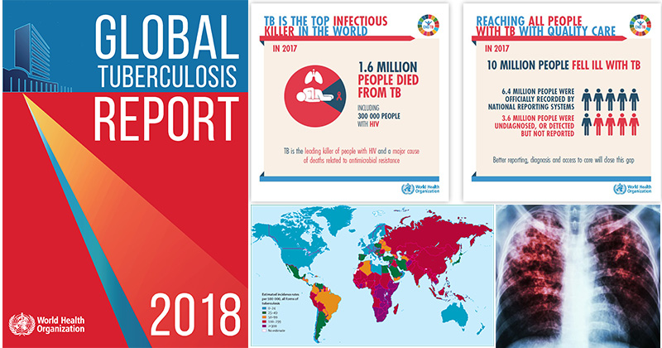
Global burden of TB

Slide 5
Burden of TB in women
3.2 million women
0.5 million deaths
higher risk of tuberculosis in people living with HIV
well documented higher prevalence of HIV in young women
Notes:
global predominance of TB in men

Slide 6
TB & pregnancy
adverse effects on each other and poor outcomes
unfavourable maternal and foetal outcomes
maternal morbidity & mortality
2-fold increase in preterm birth, low birthweight
Rapid and accurate diagnosis of TB is complicated
non-specific & overlapping symptoms (often mimic pregnancy)
extra-pulmonary TB
risks to the foetus – diagnostic tools
Notes:
TB has been recognized as a serious cause of morbidity and mortality in pregnancy for over a century.
in low income countries TB kills more women than all causes of maternal mortality combined
six-fold increase in perinatal death

Slide 7
Burden of TB during pregnancy
sparse data regarding TB during pregnancy and postpartum
most countries do not systematically collect data on TB
The burden of TB in pregnant women is substantial
prevalence
review of available data
0.06% to 0.25% in low-burden countries
0.07% to 0.5% HIV-negative women in high-burden countries
0.7% to 11% HIV-positive women in high-burden countries
epidemiological modelling study
210 per 100,000 pregnant women globally in 2011 (95% confidence interval [CI] 180–240)
higher prevalence in HIV-positive
post-partum period identified as high risk for TB
Odayar et al. 2018, Sugarman et al. 2014, Mathad & Gupta 2012

Slide 8
Pregnancy as a risk factor for tuberculosis
The effect of pregnancy on TB risk is contentious
increased risk of TB during pregnancy
Immunological changes associated with pregnancy
opportunity for mycobacterial infection or re-activation
no studies that systematically assessed the direct relationship of pregnancy and the risk of tuberculosis
Bates et al. 2015, Getahun et al. 2012
Notes:
The Hippocratic view that pregnancy was beneﬁcial to tuberculosis was generally held until the 19th century
pregnancy having a deleterious effect on tuberculosis, so much so that abortion was recommended

Slide 9
Aims
to perform a rapid review and meta-analysis of the data available in order to quantify the risk of TB during pregnancy and postpartum
to estimate the global and country-level burden of TB disease among pregnant and post-partum women
to estimate the RISK-adjusted global and country-level burden of TB disease among pregnant and post-partum women

Slide 10
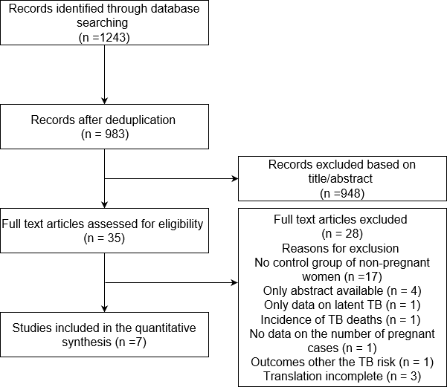
Prisma flow diagram
PROSPERO 2018, CRD42018111690

Slide 11
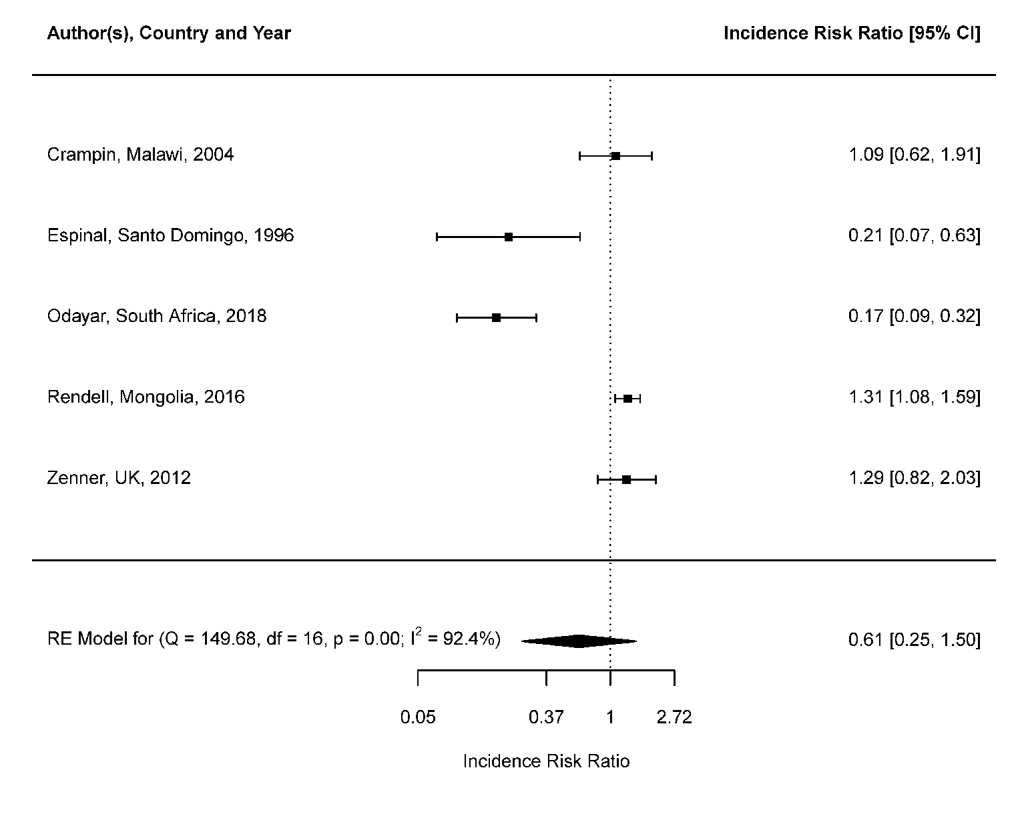
Risk of TB in pregnancy

Slide 12
Author(s), Country and Year
Incidence Risk Ratio [95% CI]
Crampin, Malawi, 2004
1.09 [0.62, 1.91]
Espinal, Santo Domingo, 1996
0.21 [0.07, 0.63]
Odayar, South Africa, 2018
0.17 [0.09, 0.32]
Rendell, Mongolia, 2016
1.31 [1.08, 1.59]
Zenner, UK, 2012
1.29 [0.82, 2.03]
RE Model for (Q = 149.68, df = 16, p = 0.00; I² = 92.4%)
0.61 [0.25, 1.50]
0.05
0.37 1
Incidence Risk Ratio
2.72

Slide 13
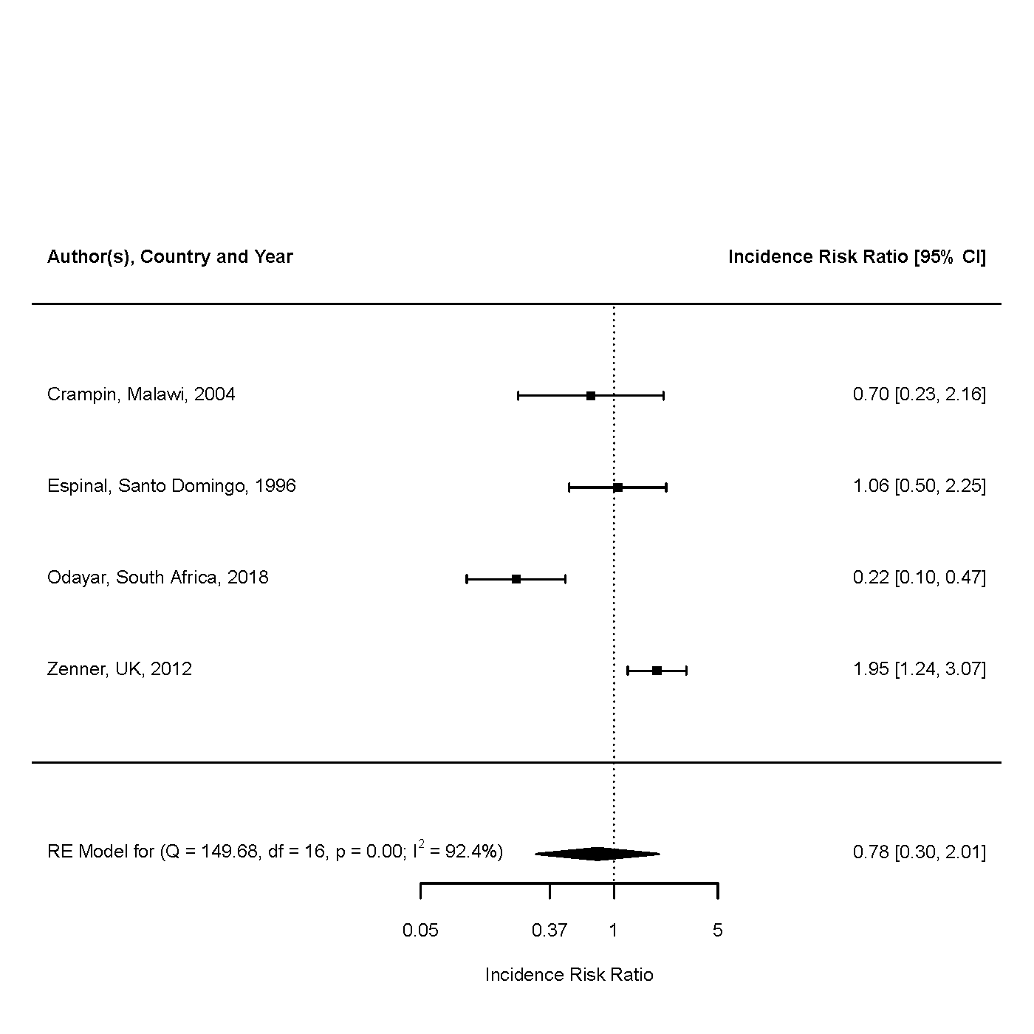
Risk of TB in postpartum period

Slide 14
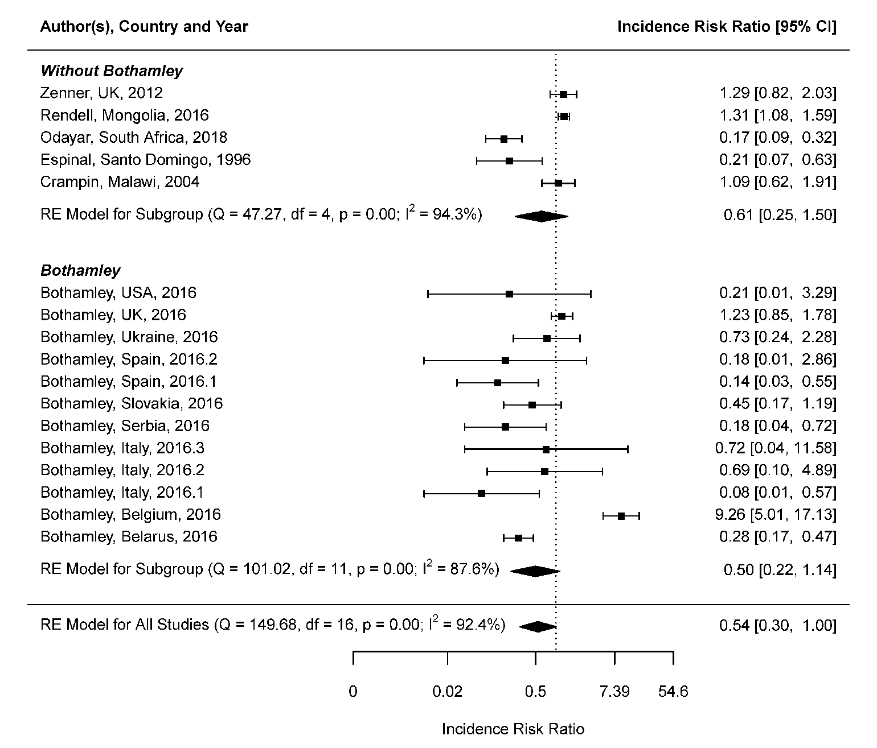
Risk of TB in pregnancy

Slide 15
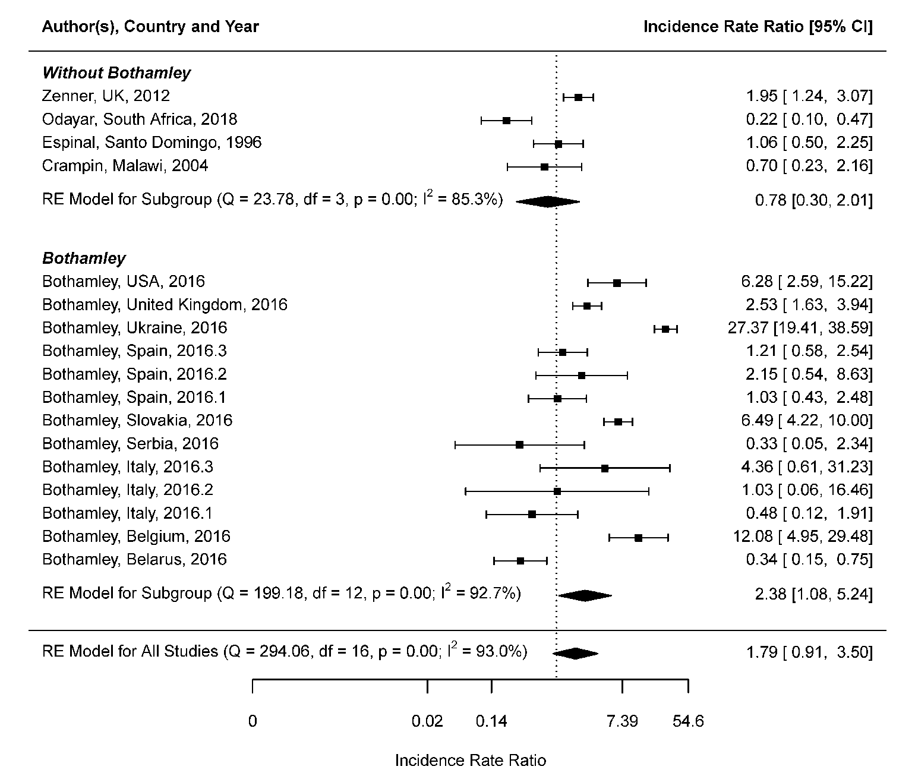
Risk of TB in postpartum period

Slide 16
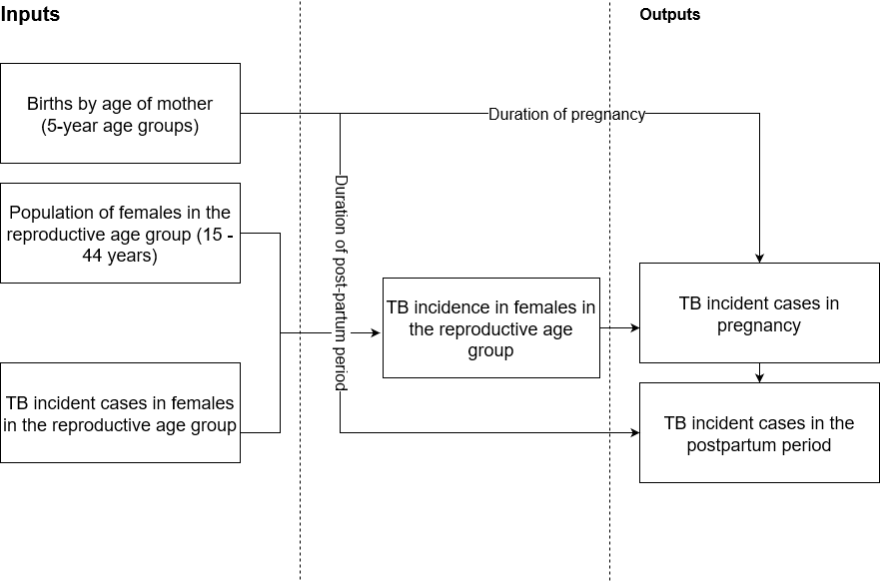
Estimation of burden of TB disease among pregnant and post-partum women

Slide 17
Burden of TB disease among pregnant and post-partum women

Slide 18
Author(s), Country and Year
Incidence Risk Ratio [95% CI]
Without Bothamley
Zenner, UK, 2012
Rendell, Mongolia, 2016 Odayar, South Africa, 2018 Espinal, Santo Domingo, 1996 Crampin, Malawi, 2004
1.29 [0.82, 2.03]
1.31 [1.08, 1.59]
0.17 [0.09, 0.32]
0.21 [0.07, 0.63]
1.09 [0.62, 1.91]
RE Model for Subgroup (Q = 47.27, df = 4, p = 0.00; I² = 94.3%)
0.61 [0.25, 1.50]
Bothamley
Bothamley, USA, 2016
0.21 [0.01, 3.29]
1.23 [0.85, 1.78]
0.73 [0.24, 2.28]
0.18 [0.01, 2.86]
0.14 [0.03, 0.55]
0.45 [0.17, 1.19]
0.18 [0.04, 0.72]
0.72 [0.04, 11.58]
0.69 [0.10, 4.89]
0.08 [0.01, 0.57]
9.26 [5.01, 17.13]
0.28 [0.17, 0.47]
0.50 [0.22, 1.14]
Bothamley, UK, 2016
Bothamley, Ukraine, 2016
Bothamley, Spain, 2016.2
Bothamley, Spain, 2016.1
Bothamley, Slovakia, 2016
Bothamley, Serbia, 2016
Bothamley, Italy, 2016.3
Bothamley, Italy, 2016.2
Bothamley, Italy, 2016.1
Bothamley, Belgium, 2016
Bothamley, Belarus, 2016
RE Model for Subgroup (Q = 101.02, df = 11, p = 0.00; I² = 87.6%)
RE Model for All Studies (Q = 149.68, df = 16, p = 0.00; I² = 92.4%)
0.54 [0.30, 1.00]
0
0.02 0.14
Incidence Risk Ratio
7.39
54.6

